Slide 1
Motion Planning in Klamp’t
Kris Hauser
ECE 383 / ME 442
Notes:
<number>

Slide 2
Agenda
Motion planning in Klamp’t
Key concepts
CSpace
Feasibility checker (static collision checking)
Visibility checker (dynamic collision checking)
MotionPlan
Klamp’t Python API

Slide 3
Toolkit Components (today)
Modeling
Planning
3D math & geometry
Paths & trajectories
Inverse Kinematics
Motion planning
Dynamics
Forward Kinematics
Path smoothing
Trajectory optimization
Contact mechanics
Physics simulation
Design tools
Visualization
System integration
Robot posing
Motion design
ROS interface
JSON / Sockets
Physics simulation
Path planning
Disk I/O

Slide 4
Context
Two possible motion planning abstraction levels:
C-space level (more control and generality)
Input: C-obstacles and endpoints
Output: a path
Robot level (more convenience)
Input: robot, workspace obstacles, endpoints or high-level tasks
Output: a path
Comparison to other packages:
Open Motion Planning Library (OMPL): implements many PRM-style planning algorithms at C-space level
MoveIt! and OpenRAVE: work at robot level (robot obstacle avoidance and manipulation problems, respectively) and set up C-space constraints for other planners
Klamp’t
Implements many PRM-style planners at C-space level (& interface to OMPL)
Supports some common problem setups at robot level (e.g., robot avoiding obstacles, with/without IK constraints)

Slide 5
Kinematic planning pipeline
Construct a planning problem
C-space
Terminal conditions (start and goal configurations, or in general, sets)
Instantiate a planning algorithm
Take care: some algorithms work with some problems and not others
Call the planner
Sampling-based planners are set up for use in any-time fashion
Plan as long as you want in a while loop, OR
Set up a termination criterion
Likelihood of success increases as more time spent
For optimizing planners, quality of path improves too
Retrieve the path (sequence of milestones)

Slide 6
Setting up a kinematic C-space
C-Space-level interface: you must manually implement the callbacks used by the planning algorithm
Feasibility tester IsFeasible?(q)
Visibility tester IsVisible?(a,b)
Sampling strategy q <- SampleConfig()
*Perturbation sampling strategy q <- SampleNeighborhood(c,r)
*Distance metric d <- Distance(a,b)
*Interpolation function q <- Interpolate(a,b,u)
*: default implementation assumes Cartesian space
Robot-level interface: you provide a world containing a robot
Standard Robot C-Space: avoids collisions
Contact C-space: avoids collisions, maintains IK constraints
Stance C-space: same as Contact C-space, but also enforces balance under gravity

Slide 7
C-Space interface

Slide 8
Python API (CSpace)
To set up your own problem, construct a subclass of the CSpace class whose methods will be called by the planner
class MyCSpace(CSpace): def __init__(self): CSpace.__init__(self) …
At minimum, set up the following:
bound: a list of pairs [(a₁,b₁),…,(a_{n},b_{n})] giving an n-dimensional bounding box containing the free space
eps: a visibility collision checking tolerance (more later)
feasible(q): the feasibility test. Returns True if feasible, False if infeasible
(OR call addFeasibilityTest(func,name=None) with as many feasibility tests as you want)

Slide 9
Subclassing in Python
class ParentClass:
def __init__(self,x):
self.x = x
def foo(self):
print “x is“,self.x
def bar(self):
print “2x is“,2*self.x
A = ParentClass(1)
A.foo() #this prints “x is 1”
A.bar() #this prints “2x is 2”

Slide 10
Subclassing in Python
class ParentClass:
def __init__(self,x):
self.x = x
def foo(self):
print “x is“,self.x
def bar(self):
print “2x is“,2*self.x
class SubClass(ParentClass):
def __init__(self,x,y):
ParentClass.__init__(self,x+3) #note that the argument is changed
self.y = y
def foo(self): #this overrides the parent class’s foo definition
print “y is”,self.y
print “My parent says…”
print ParentClass.foo(self)
#bar is still defined as it was before
A = SubClass(1,2)
A.foo() #this prints “y is 2” “My parent says…” “x is 4”
A.bar() #this prints “2x is 8” 2*(1+3)

Slide 11
Python API (CSpace)… more functionality
visible(a,b): used for custom visibility tests
sample(): returns a random configuration. Used for custom sampling distributions. Default implementation uses uniform distribution over self.bound.
distance(a,b): returns a distance value between configurations a and b. Default uses Euclidean distance
interpolate(a,b,u): returns a configuration u fraction of the way toward b from a. Default uses linear interpolation.
sampleneighborhood(c,r): used by some planners to sample a random configuration within a neighborhood r of the configuration c. Default samples over box of width 2r intersected with self.bound

Slide 12
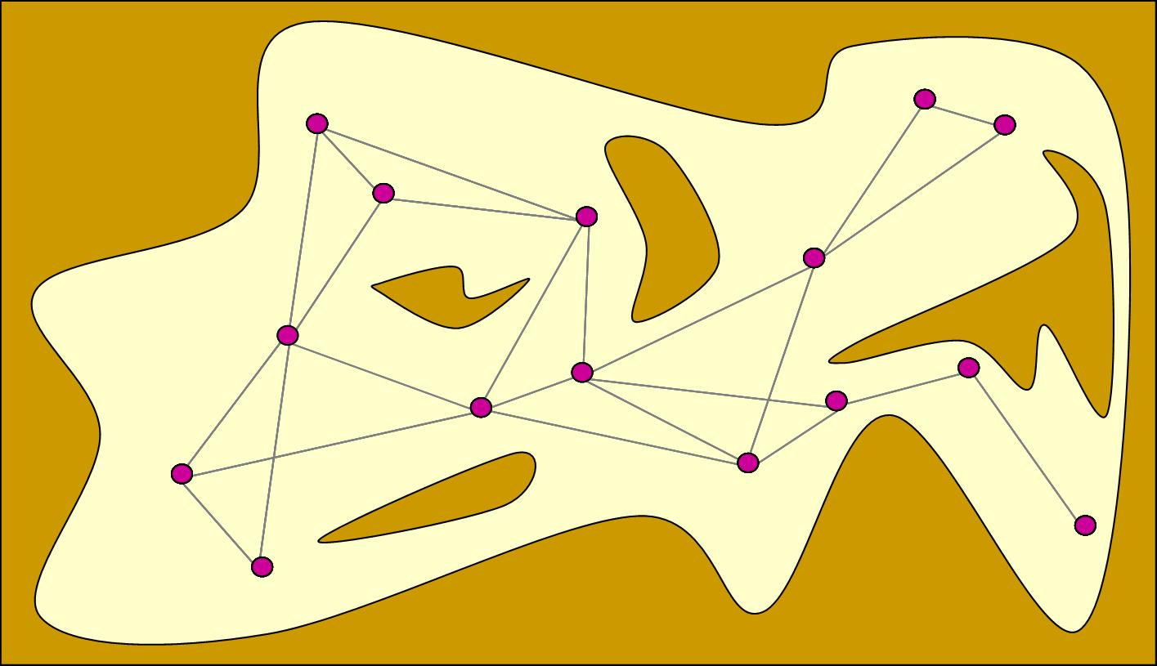
Static vs. Dynamic Collision Detection
Static checks
Dynamic checks

Slide 13
Static Feasibility Checking
Override it to test whether a configuration is feasible
CSpace.IsFeasible(q) (C++ API)
CSpace.feasible(q) (Python API)
By default, if CSpace.addFeasibilityTest has been called, CSpace.feasible(q) will check all of the specified tests
An authoritative representation of C-obstacles
Will be called thousands of times during planning. For sampling-based planners to work well, this must be fast (ideally, microseconds)
Geometric primitives, or bounding-volume hierarchies
BVHs automatically set up / cached in Klamp’t the first time collisions are queried

Slide 14
Dynamic Feasibility Checking
Callback that tests whether a simple path between two configurations is feasible (local planning)
CSpace.LocalPlanner(a,b)->EdgePlanner* (C++ API)
CSpace.visible(a,b) (Python API)
C++ API allows non-straight line paths, Python assumes straight-line paths
Will be called thousands of times during planning (hopefully far less, in lazy planners). For sampling-based planners to work well, this must be fast (ideally, milliseconds)
Default implementations use discretize-and-check approach

Slide 15
Distance metrics
Most PRM-style planners rely heavily on the notion of a distance metric
PRM (and similar planners): determines set of “nearby” neighbors for connection. Either
k-nearest neighbors, OR
All neighbors within radius R
RRT (and similar planners): determines how far to extend tree on each iteration
Max distance δ
This choice is often nontrivial due to axes with different units
Example: how to weight the angular component in SE(2)?
& Tradeoff between fast exploration vs finding intricate movements in narrow passages
Large jumps more effective
Small jumps more effective

Slide 16
Interpolation
Interpolate(a,b,u) traces out a simple path (e.g., straight line or geodesic) from a->b as u goes from 0->1
C++: CSpace.Interpolate(a,b,u,Config& q) with q used as output
Python: q<-CSpace.interpolate(a,b,u)
Output of planner: sequence of milestones m₀,…,m_{n} such subsequent application the C-space’s interpolation function traces out path
q(t) = Interpolate(m_{i},m_{i+1}, t*n-i) with i=floor(tn)
Straight line is most appropriate for Euclidean spaces (default)
Geodesic is most appropriate choice for non-Euclidean spaces

Slide 17
Robot-level interface

Slide 18
Python API (RobotCSpace)
The RobotCSpace class considers the configuration space of a RobotModel, possibly colliding with obstacles in a WorldModel
Construct an instance of RobotCSpace with the robot and a robotcollide.WorldCollider instance
from klampt.plan.robotcspcae import RobotCSpace
from klampt.model import collide
space = RobotCSpace(robot,robotcollide.WorldCollider(world))
(Can also create it without the collider to ignore all self-and environment collisions)
Optionally:
Call addFeasibilityTest(func,name=None) on the space with as many additional feasibility tests as you want

Slide 19
RobotCSpace Issues
What distance metric?
Default weights all joints evenly
What collision checking resolution?
Default eps = 0.001
How to sample non-standard joints, e.g., floating bases or freely spinning joints?
Need to overload sample() method

Slide 20
More advanced usage in robotcspace.py…
Moving just some subset of DOFs, e.g. an arm of a humanoid robot
RobotSubsetCSpace
Specify a list of DOF indices in the constructor
Moving while maintaining some IK constraints
ClosedLoopRobotCSpace
This is handled by solving IK constraints during interpolation (and by extension, visibility checking)

Slide 21
Interpolating / executing robot paths
Setup
from klampt.model import trajectory
robot = …RobotModel instance
path = …list of milestones resulting from planner…
controller = …SimRobotController instance
Interpolate
times = range(len(path)) #times at which each milestone is reached. This places them 1s apart
traj = trajectory.RobotTrajectory(robot,path,times)
q = traj.eval(5.6) #interpolates the trajectory at time 5.6
Execute
trajectory.execute_path(path,controller) #executes at max speed allowable by robot model’s velocity/acceleration limits, starting and stopping at each milestone
trajectory.execute_trajectory(traj,controller) #executes a timed trajectory in piecewise linear fashion

Slide 22
Invoking Motion Planners

Slide 23
Klamp’t planning problems
Motion planning problem types
Constraints:
Kinematic constraints
Manifold constraints (must be handled in C-space)
Dynamic constraints partially supported
Objectives:
Minimum path length well supported
Minimum execution time under dynamics partially supported
Arbitrary cost functions partially supported
Minimum constraint removal
Minimum constraint displacement
Terminal conditions: point-to-point, point-to-set (not thoroughly tested), multi-query (some planners)
Implementation:
C++: fullest support. Not every combination of constraints + objectives + terminal constraints is supported
Python: point-to-point kinematic planning, manifold constraints can be handled, only path-length supported as optimization function

Slide 24
Klamp’t planning algorithms
Feasible planners: only care about the first feasible solution
Probabilistic Roadmap (PRM) [Kavraki et al 1996]
Rapidly-Exploring Random Tree (RRT) [LaValle and Kuffner 2001]
Expansive Space Trees (EST ) [Hsu et al 1999]
Single-Query Bidirectional Lazy Planner (SBL) [Sanchez-Ante and Latombe 2004]
Probabilistic Roadmap of Trees [Akinc et al 2005] w/ SBL (SBL-PRT)
Multi-Modal PRM (MMPRM), Incremental-MMPRM [Hauser and Latombe 2009]
Optimizing planners: incrementally improve the solution quality over time (path length)
RRT* [Karaman and Frazzoli 2009]
PRM* [Karaman and Frazzoli 2009]
Lazy-PRM*, Lazy-RRG* [Hauser 2015]
Lower-Bound RRT* (LB-RRT*) [Salzman and Halperin 2014]
Fast Marching Method (FMM) [Sethian 1996]
Asymptotically optimal FMM (FMM*) [Luo and Hauser 2014]
Minimum Constraint Removal (MCR) and Minimum Constraint Displacement (MCD) [Hauser 2013]
Randomized path shortcutting
Random restarts
Implementation:
C++: fullest support. Automatic configuration interface for PRM, RRT, EST, SBL, SBL-PRT, RRT*, PRM*, Lazy-PRM*, Lazy-RRG*, LB-RRT*, FMM, FMM*, shortcutting, restarts
Python: Only supports automatic configuration interface

Slide 25
Python API (MotionPlan)
Sets up a motion planner for a given CSpace
First call global configuration
MotionPlan.setOptions(option₁=value₁,…,option_{k}=value_{k})
Then create the planner, set up the endpoints, and call in a loop
planner = MotionPlan(cspace)
planner.setEndpoints(qstart,qgoal)
increment = 100
while [TIME LEFT]:
planner.planMore(increment)
path = planner.getPath()
if len(path) > 0:
print “Solved”; break
Note: if you are creating lots of MotionPlans you will want to call planner.close() to free memory after using it
Note: many planners require start and goal to be feasible… or throw an exception

Slide 26
Python API (MotionPlan) Planner options
MotionPlan.setOptions(option₁=value₁,…,option_{k}=value_{k})
Common options:
type: identifies the planning algorithm. Can be “prm”, “rrt”, “est”, “sbl”, “sblprt”, “rrt*”, “prm*”, “lazyprm*”, “lazyrrg*”, “fmm”, “fmm*”
connectionThreshold: used in prm, rrt
perturbationRadius: used in rrt, est, sbl, sblprt
bidirectional: if true, performs bidirectional planning. Used in rrt, rrt*, lazyrrg*
pointLocation: point location method. [empty]: naïve, “kdtree”: KD-Tree, “randombest [k]”: best of k random samples
shortcut: 0 or 1, indicates whether to perform shortcutting after planning
restart: 0 or 1, indicates whether to perform random restarts (used with restartTermCond)
restartTermCond: a JSON string indicating the termination criterion for each random restart.
Options can also be loaded from a JSON string (see Examples/PlanDemo/*.settings) via motionplanning.setPlanJSONString(string)

